Slide 1
Simulation and Modeling
CSE4131_CSE4132

Slide 2
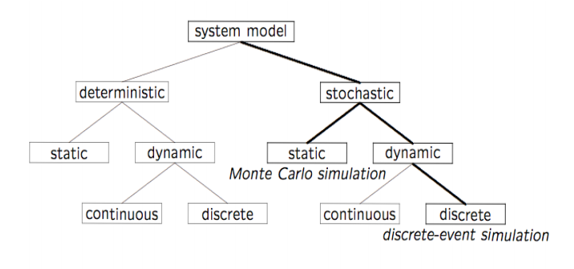
System Model Classification
Who uses random number…

Slide 3
Random Numbers
What is Random Number?
A random number is a number generated by a process,
whose outcome is unpredictable,
and which cannot be sub sequentially reliably reproduced.
This definition … one has some kind of a black box – such a black box is usually called a random number generator – that fulfills this task.
Random number plays important role in simulation tasks.

Slide 4
Properties of Random Numbers
A sequence of random numbers, R₁, R₂ … must have two important statistical properties:
Uniformity → ?
They are equally probable every where
If the interval [0, l] is divided into n classes, the expected number of observations in each interval is N/n, where N is the total number of observations.
Independence → ?
The current value of a random variable has no relation with the previous value.
The probability of observing a value in a particular interval is independent of the previous values drawn.

Slide 5
Generation of Pseudo Random Numbers
Pseudo → False / Fake
Generation of False or Fake Random Numbers?
Pseudo "pseudo" is used to imply that the very act of generating random numbers by a known method removes the potential for true randomness.
Goal → The goal of any generation scheme, however, is to produce a sequence of numbers between 0 and 1
that simulates, or imitates, the ideal properties of uniform distribution and independence as closely as possible.

Slide 6
Generation of Pseudo Random Numbers
Important considerations in RN routines:
The routine should be fast
The routine should be portable to different computer… (different programming languages)
The routine should have a sufficiently long cycle
The random numbers should be replicable.
The random numbers should Closely approximate the ideal statistical properties of uniformity and independence

Slide 7
Generation of Pseudo Random Numbers
When generating pseudo random numbers certain problem may occur:
The generated numbers might not be uniformly distributed.
The generated numbers might be discrete-valued instead of continuous-valued.
The mean of the generated numbers might be too high or too low.
The variance of the generated numbers might be too high or too low.
There might be dependence. The following are examples:
autocorrelation between numbers;
numbers successively higher or lower than adjacent numbers;
several numbers above the mean followed by several numbers below the mean.

Slide 8
Techniques of Generating Random Numbers
Different methods have been proposed:
Linear Congruential Method (LCM).
Combined Linear Congruential Generators (CLCG).
Random-Number Streams.

Slide 9
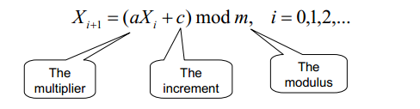
Linear Congruential Method (LCM)
Congruential → Congruent → Similar/ fitting /matching
Proposed by Lehmer (1951)
To produce a sequence of integers, X₁, X₂, …between 0 and m-1 by following a recursive relationship
The initial value of X₀ is called seed.
a is called constant multiplier.
c → increment
m → modulus

Slide 10

Linear Congruential Method (LCM)
If c ≠ 0 then → Mixed Congruential method
If c = 0 then → Multiplicative Congruential method
The random integers are being generated [0,m-1 ], and to convert the integers to random numbers:

Slide 11
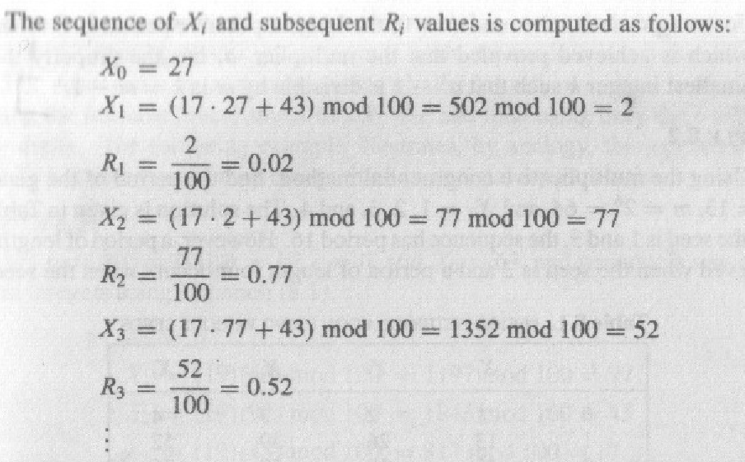
An Example
Given,
Seed (X₀ )= 27 ,
Constant multiplier (a) = 17 ,
Increment (c) = 43 , and
modulus (m) = 100.

